Slide 1
Finding Genome Reference for Kallisto

Slide 2
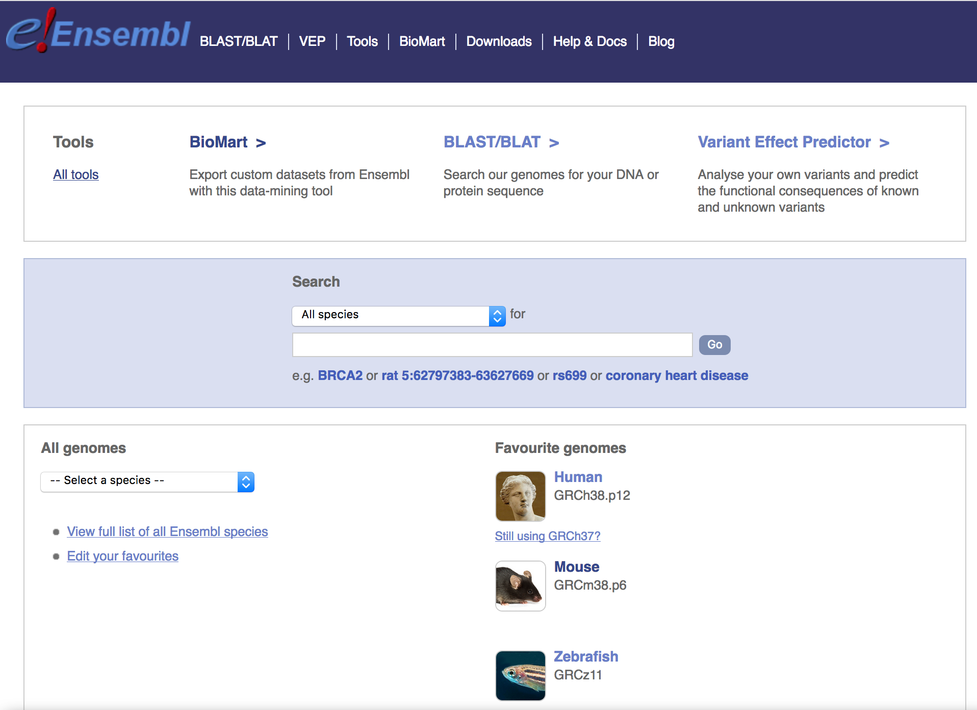
Step 1: Ensembl Website and Search Species
http://www.ensemble.org
Search Species Here

Slide 3
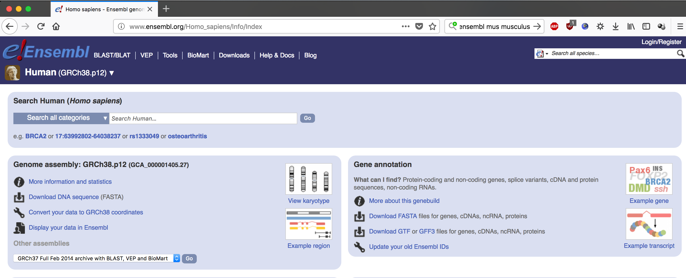
Step 2: Find Link for cDNA
FASTA for cDNA
This will direct you to FTP

Slide 4
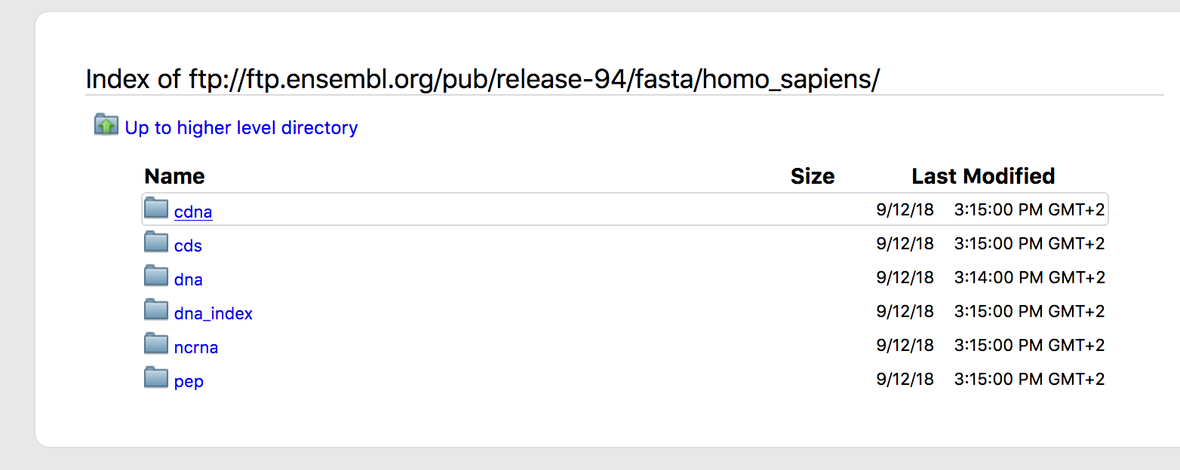
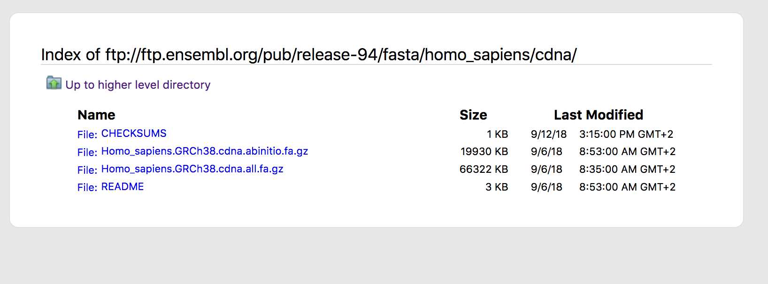
Step 3: Download Files

